Slide 1


NCL
Class1
- 2023 / 02 / 23 -
Speaker:
Yu-Shen, Lin

Slide 2

Course Schedule
02
2/23
Introduction of NCL
03
3/02
NCL Programing & Graphics
04
3/09
NCL Programing & Graphics
05
3/16
EOF analysis
06
3/23
Fortran subscript
07
3/30
Application of NCL / MATLAB
09
4/13 – 6/15
Meeting with professor Yu / Wang

Slide 3
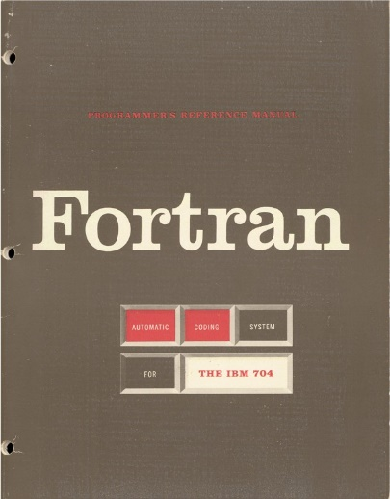




Introduction
NCL Operation
Data Structure
File I/O
Overview of Plots
GrADS

Slide 4
Introduction

Slide 5

Introduction
05
Basic Linux commands
pwd | Print working directory (folder)
cd | Go straight to the home directory
cd /dir | Navigate through the files/directories
cd .. | To move one directory up
ls | List the contents of a directory
cp file newfile | Copy files
cp file /dir | Copy files to the directory
cp -r dir | Copy directories
mv file /dir mv file newfile | Move files or rename files
mkdir dir | Make a new directory
rm file rm -r dir | Delete files or directories
rm -f file | Delete files without warning
top | Display a list of running processes and how much CPU each process uses
vi | Create a new file ( i → write / q! → quit without saving / wq! → save and quit )
man command | Information for each of the commands on your Linux system

Slide 6
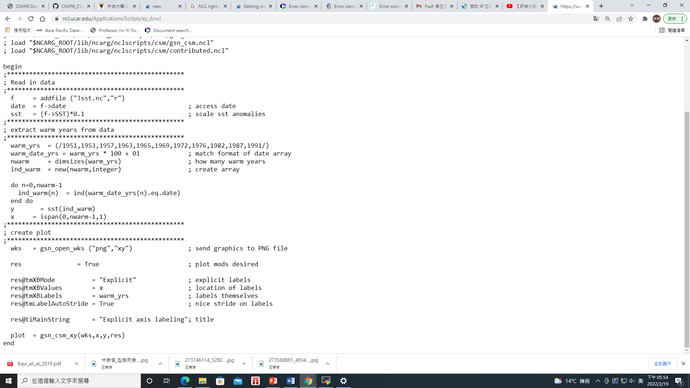
Introduction
06
Access
What is NCL?
Analysis
The NCAR Command Language (NCL) is an interpreted programming language.
Designed for the access, analysis, and visualization of data.
Visualization

Slide 7
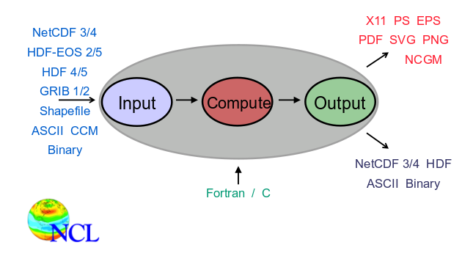

Introduction
07
Powerful, straightforward, widely-used, easy self-learning, and useful.
Figures
Supported Formats
Files
Common data structure:
NetCDF

Slide 8
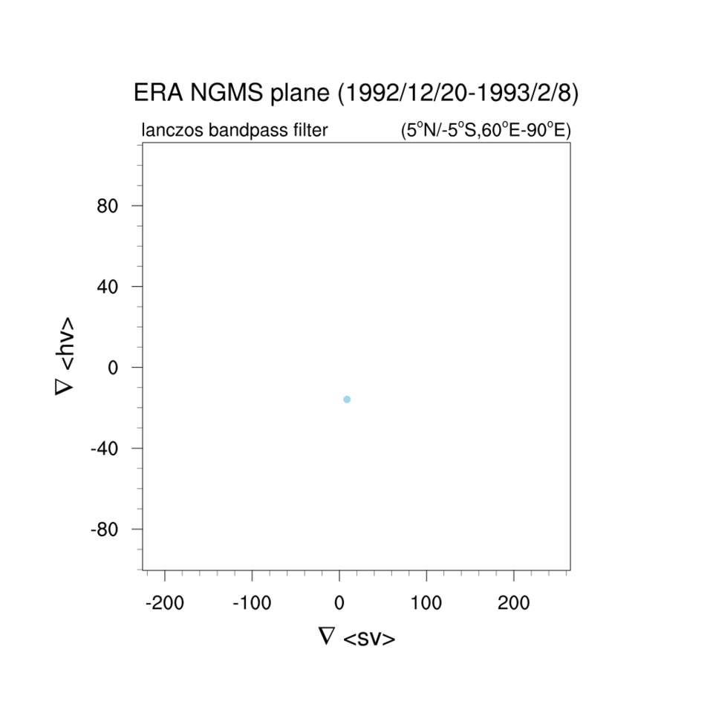
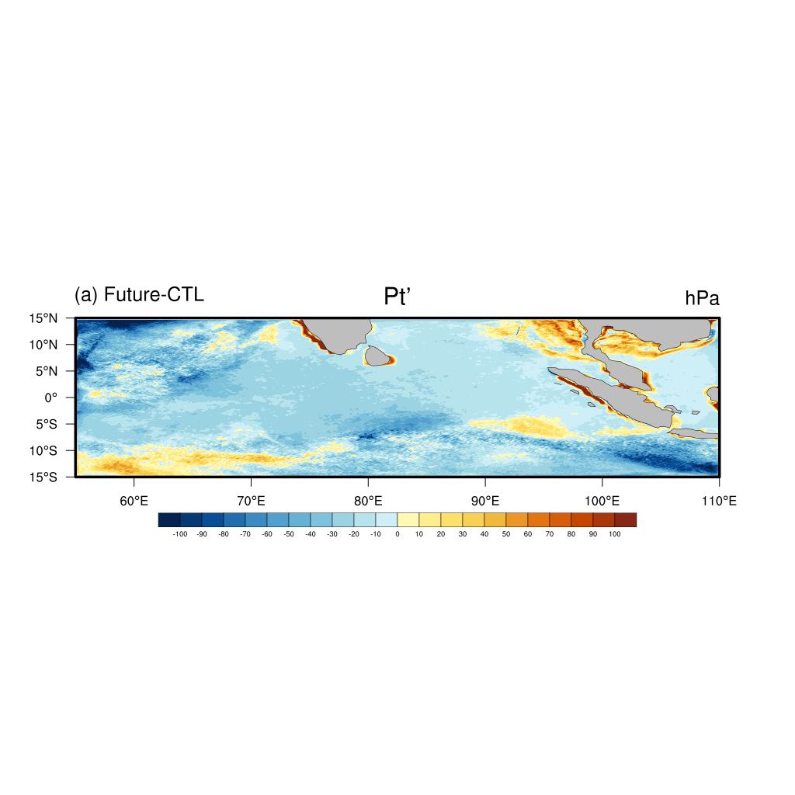
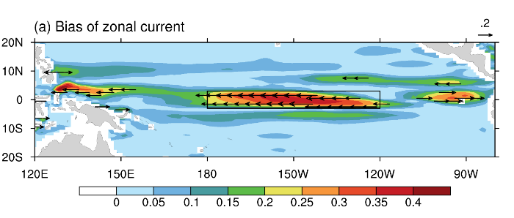
08
by Yu-Cian

Slide 9
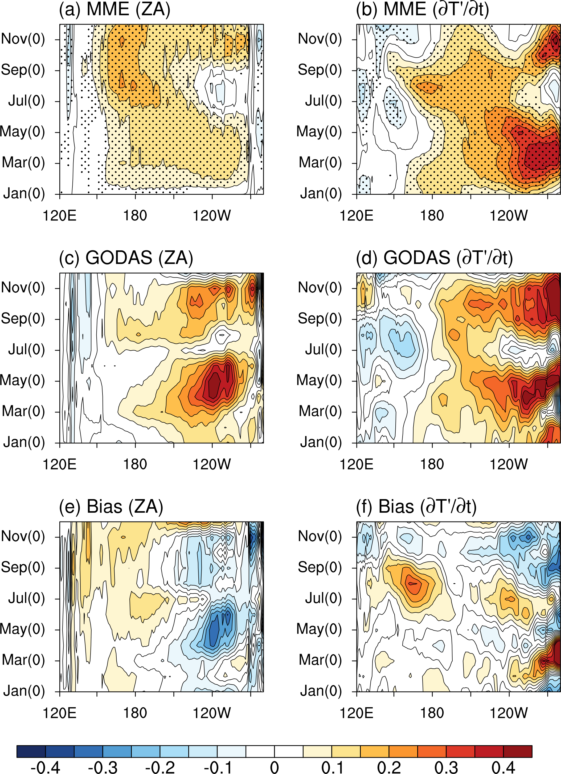
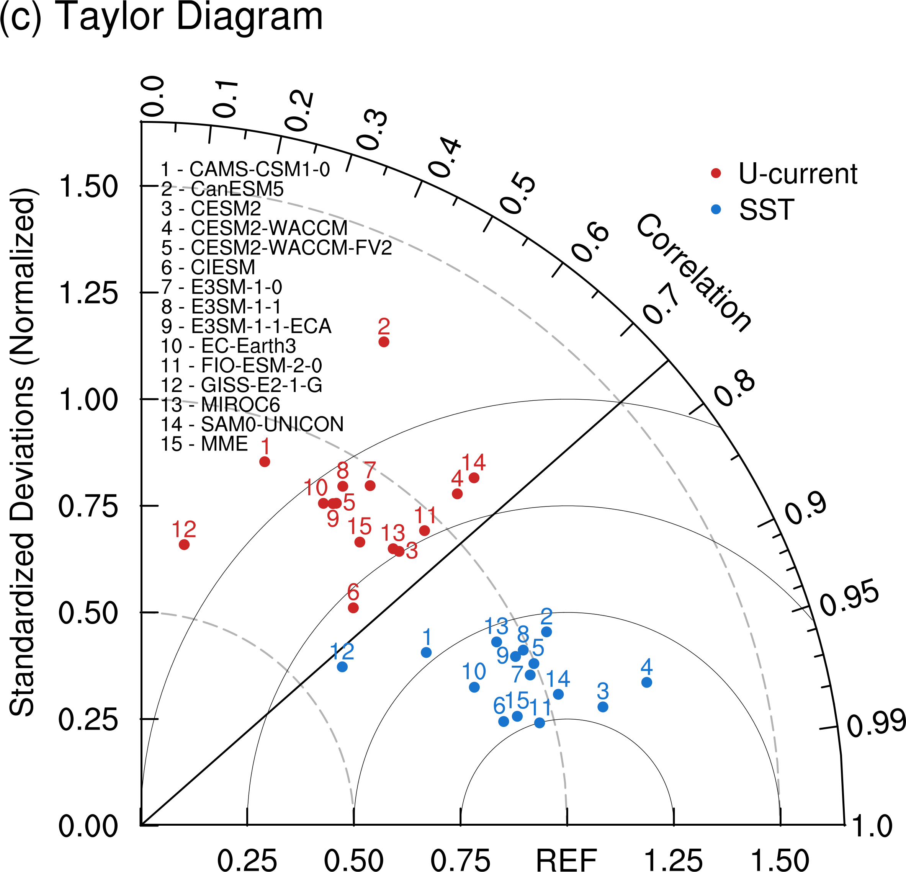
09

Slide 10
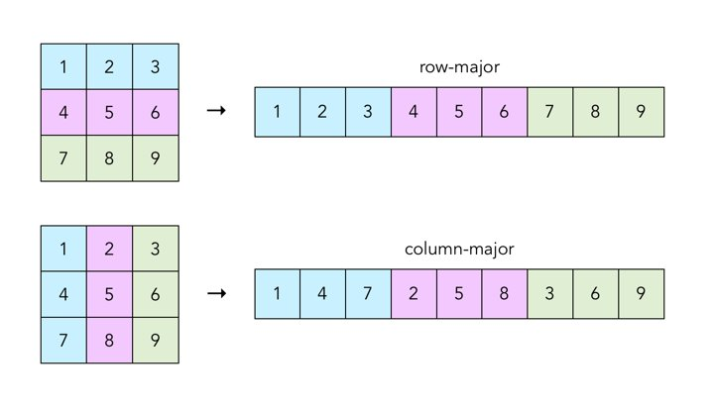
Introduction
10
NCL
Fortran
But you would not “feel” something different when you’re using matrix…

Slide 11
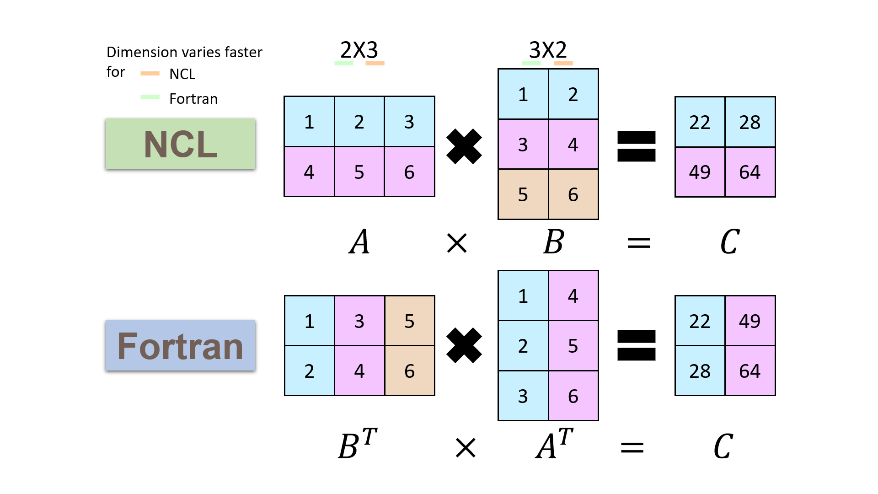
Dimension varies faster for
Introduction
11
NCL
Fortran
NCL
(0,0) 22
(0,1) 28
(1,0) 49
(1,1) 64
Fortran
22 28 49 64

Slide 12
NCL Operation

Slide 13
NCL Operation
13
Consider a variable T:
T( : , : , : , : )
Example: T(time, lev, lat, lon)
Dimension → ( 0, 1, 2, 3)
Varies slowest
Varies fastest
Note
Array is always the fastest, so don’t use do-loop if possible.
When using lots of do-loops, try Fortran (left first) to boost.
NCL：x(time,lev,lat,lon) <==> Fortran：x(lon,lat,lev,time)

Slide 14
NCL Operation
14
Common syntax
Symbol | Description | Example
; | Begins a comment. Text on the right-hand side is ignored
/; … ;/ | Block comment. All text/lines bracketed are ignored (available in V6.4.0)
= | Assignment | a = 0
:= | Reassignment (available in V6.1.2) | a := 50
"…" | String | M = "model"
(/.../) | Construct an array | A = (/ (/1,3/) , (/5,7/) /) ;2x2
@ | Create or reference attributes | X@_FillValue = -999
! | Create or reference named dimensions | X!2 = "lat"
& | Create or reference a coordinate variable | X&lat = rlat

Slide 15
NCL Operation
15
Common syntax
Symbol | Description | Example
: | Used for a range subscript selection | T( 0:20, 5 )
 | Can be reversed using a negative stride | T( ::-1, ::-1 )
 | Can be subsampled using a positive stride | T( ::2, 20:90:2 )
{...} | Used for coordinate subscripting | T = t( {-5:5}, : )
| | Used as a separator for named dimensions | T = t( lon|: , lat|: )
\ | Continue statement for spanning multiple lines
+ | String concatenation | tm = M+"_TaiESM1"

Slide 16
NCL Operation
16
Expressions
Algebraic |  | Logical
+ | Addition | .lt. | Less than
- | Subtraction | .le. | Less than or equal to
* | Multiplication | .gt. | Greater than
^ | Exponent | .ne. | Not equal to
/ | Division | .eq. | Equal to
% | Modulus, integers only | .and. | And
# | Matrix multiply | .or. | Or
>, < | Greater than, less than | .xor. | Exclusive or
 |  | .not. | Not

Slide 17
NCL Operation
17
Loop/if
do n = start, end, optional_stride [statement(s)] end do | do while (scalar_logical_expression) [statement(s)] end do
do n = start, end, optional_stride [statement(s)] break end do | do n = start, end, optional_stride [statement(s)] continue end do

Slide 18
NCL Operation
18
Loop/if
if (scalar_logical_expression) then [statement(s)] end if | if (scalar_logical_expression) then [A_statement(s)] elseif (scalar_logical_expression) then [B_statement(s)] elseif (scalar_logical_expression) then [C_statement(s)] else [D_statement(s)] end if ; C & D end if ; B end if ; A
if (scalar_logical_expression) then [statement(s)] else [statement(s)] end if

Slide 19
Data Structure

Slide 20

Data Structure
20
About NetCDF
Common atmospheric data format
Filename Extension : ".nc"
Self-described data format
NCAR’s product as NCL
The same way to setup the variable as NCL
ncdump -h *.nc
Show the header information
Information on supported data formats
ncl_convert2nc
It converts one or more GRIB1, GRIB2, HDF 4, HDF-EOS 2, HDF-EOS 5, and/or shapefile files to NetCDF formatted files.

Slide 21

Data Structure
21
Types
Numeric | Non-numeric
Integer (32 bit) | String
Float (32 bit) | Graphics
Double (64bit) | File
Short (16bit)
Example
Type converters
Those functions convert between various NCL data types. The bulk of the functions convert between bytes, shorts, integers, floats, longs, doubles, characters, and strings.
Note that complex is NOT supported in NCL!

Slide 22
Data Structure
22
Types
Numeric | Non-numeric
Integer (32 bit) | String
Float (32 bit) | Graphics
Double (64bit) | File
Short (16bit)
Creates an NCL variable
E.g.
T = new((/2,2/),"integer")
U = new((/12,17,180,360/),"float")

Slide 23
Data Structure
23
Data types
Numeric | Non-numeric
Integer (32 bit) | String
Float (32 bit) | Graphics
Double (64bit) | File
Short (16bit)
@_FillValue
a.k.a. Missing value
Differs in different types
Type | V5.2.x and earlier | V6.x and later
short | -99 | -32767
integer | -999 | -2147483647
float | -999 | 9.96921e+36
double | -9999 | 9.969209968386869e+36
E.g.
T = new((/2,2/),"integer")
U = new((/12,17,180,360/),"float")

Slide 24
Data Structure
24
Metadata
It summarizes basic information about data, making finding & working with particular instances of data easier.
Metadata can be created manually to be more accurate, or automatically and contain more basic information.
Data
Attributes
Coordinates
Scalar or Array
@long_name
@_FillValue
@units
@scale_factor
…
time
lev
lat
lon
…
Take a look at the data structure in NetCDF file.

Slide 25
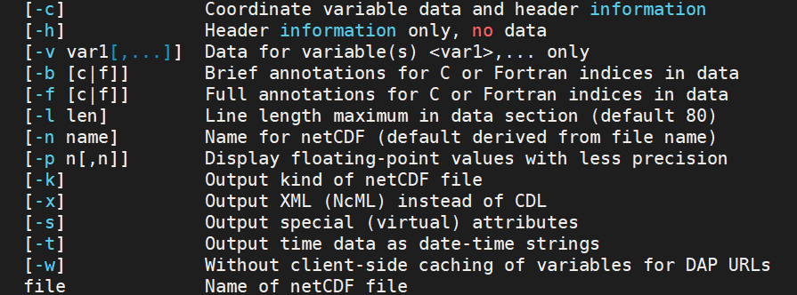
Data Structure
25
Browse through the data
The ncdump is used as a simple browser for NetCDF data files.

Slide 26
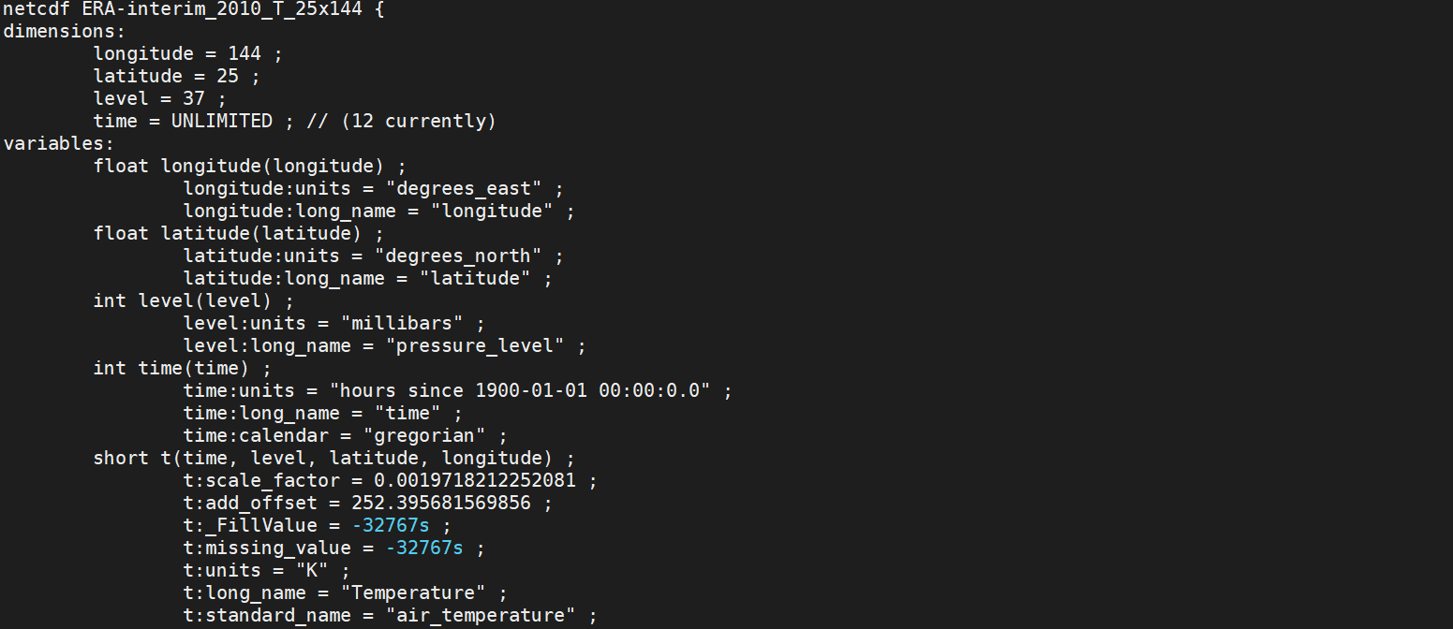
Data Structure
26
ncdump *.nc |less
Browse through the data
The ncdump is used as a simple browser for NetCDF data files.
Information associated with a variable or file (assign with @ character)
- Any data type except file or list
- Scalar, multi dimensional array (string,
numeric)
e.g.
T@units = “degC”
T@long_name = “Temperature”
T@wgts = (/ 0.25, 0.5, 0.25 /)
T@x2d = (/ (/1,2,3/), (/4,5,6/), (/7,8,9/) /)
T@_FillValue = -999
title = T@long_name

Slide 27
File I/O

Slide 28
File I/O
28
Function for opening data file
One file
f = addfile( file_name.nc, status )
Var = f->var
I O
"r" [read: all supported formats]
"c" [create: NetCDF, HDF only]
"w" [read/write: NetCDF, HDF only]
Read the variable you need
(must be the same name in header information)

Slide 29
File I/O
29
Function for opening data file
One file
f = addfile( file_name.nc, status )
Var = f->var
fout = addfile( “./out.nc”, “c” )
fout->VAR = Var
I O
"r" [read: all supported formats]
"c" [create: NetCDF, HDF only]
"w" [read/write: NetCDF, HDF only]
Original variable
Read the variable you need
(must be the same name in header information)
The variable name of your output data
Example
dir = "/data/course/ERA-Interim/Monthly/0.5x0.5/Global/T"
f = addfile( dir+"/EC_T_mon_1997.nc","r" )
T = short2flt( f->t )
printVarSummary(T)

Slide 30
File I/O
30
Function for opening data file
One file
f = addfile( file_name.nc, status )
Var = f->var
fout = addfile("./out.nc", "c" )
fout->VAR = Var
I O
"r" [read: all supported formats]
"c" [create: NetCDF, HDF only]
"w" [read/write: NetCDF, HDF only]
Original variable
Read the variable you need
(must be the same name in header information)
The variable name of your output data
Example
dir = "/data/course/ERA-Interim/Monthly/0.5x0.5/Global/T"
f = addfile( dir+"/EC_T_mon_1997.nc","r" )
T = short2flt( f->t )
printVarSummary(T)

Slide 31
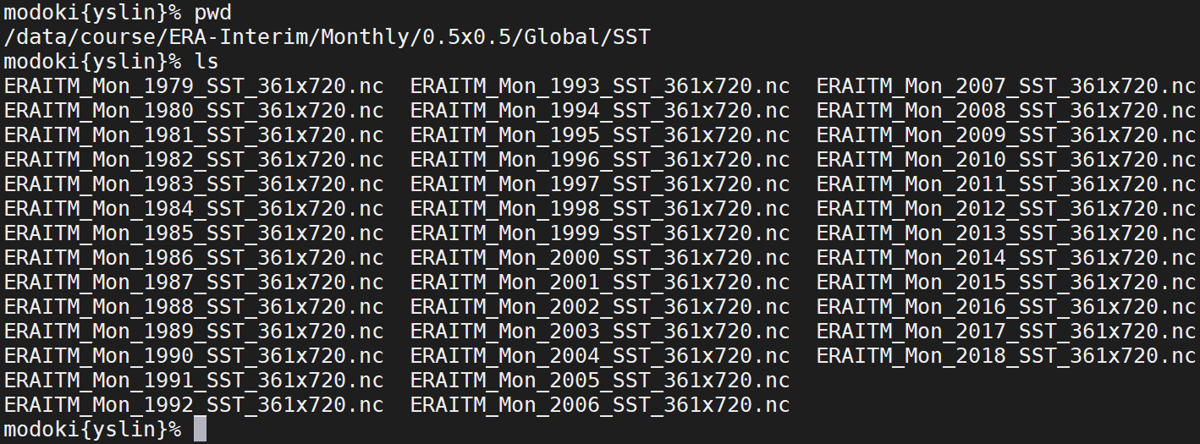
File I/O
31
Files
There are several files in "/data/course/ERA-Interim/Monthly/0.5x0.5/Global/SST"

Slide 32
File I/O
32
Files
There are several files in "/data/course/ERA-Interim/Monthly/0.5x0.5/Global/SST"
Example
dir = "/data/course/ERA-Interim/Monthly/0.5x0.5/Global/SST"
fls = systemfunc("ls "+dir+"/*.nc")
f = addfiles(fls,"r")
ListSetType(f,"cat")
T = f[:]->sst
printVarSummary(T)
Read all the files in the directory
Functions
How the file list after reading
Read t from all files
Cat
[ time | 480 ] x [ latitude | 361 ] x [ longitude | 720 ]
Join
[ ncl_join | 40 ] x [ time | 12 ] x [ latitude | 361 ] x [ longitude | 720 ]

Slide 33
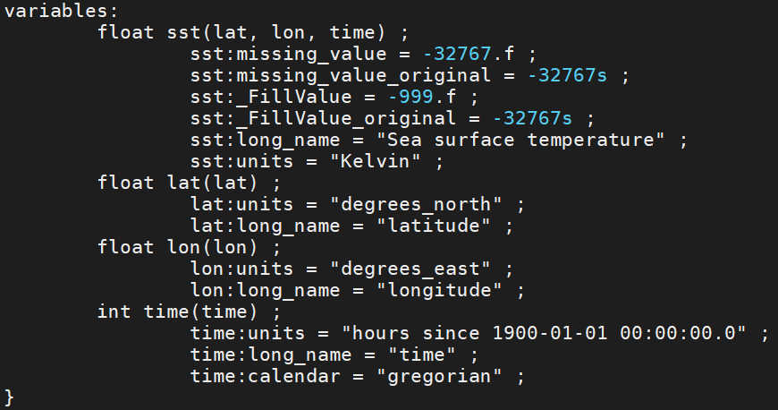
File I/O
33
Practice
Choose a file in "/data/course/ERA-Interim/Monthly/0.5x0.5/Global/SST"

Slide 34
Overview of Plots

Slide 35
Overview of Plots
35
Workspace
gsn_open_wks: create a workspace
"png": type of graphics
"xy": file name
NCL Resources
Resources are the means by which we modify NCL graphics.
wks setting
res (resources)
named color & table
add_poly…
Overlay plots
Font adjustment
Plot Type Examples
Graphical Interfaces
NCL Visualization Gallery
Search
Plot
Basic skills

Slide 36
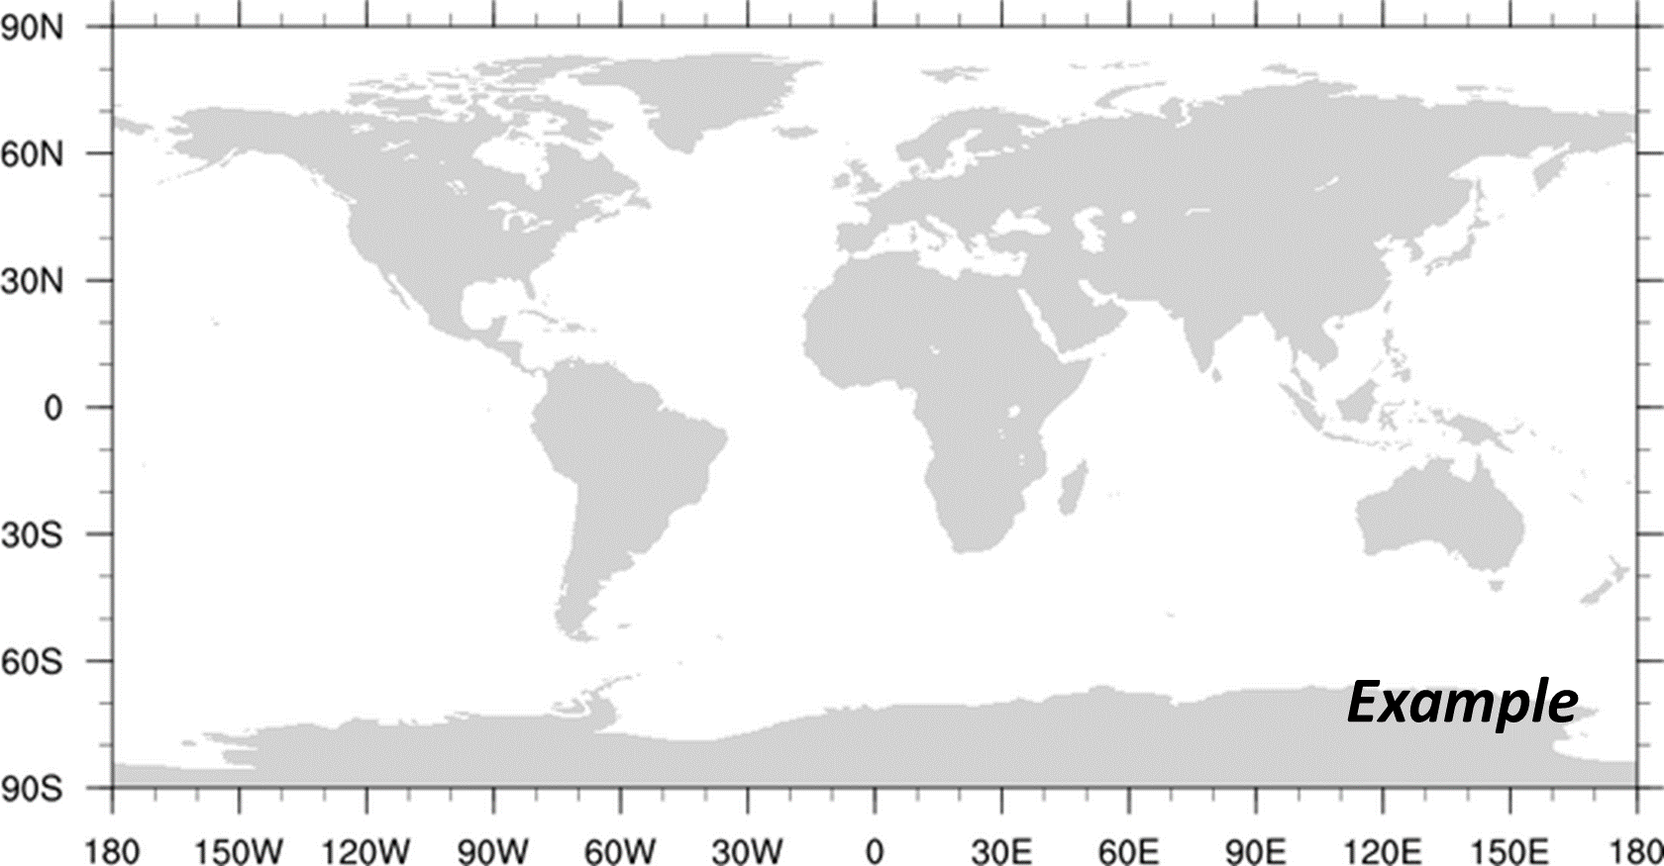
Homework-1
36
HW1-1
Use NCL code to calculate 1+4+7+10+13+16+19+…+1000, then print it.
Create a variable with a 2X3 array (named [ D1| 2 ] x [ D2 | 3 ], _FillValue = -999, type of float).
Put the number into (1, 2).
Output the variable in [your name + _hw1.nc].
HW1-2
Draw the below figure and print it with the file named [your name + _hw1.png].
hint

Slide 37
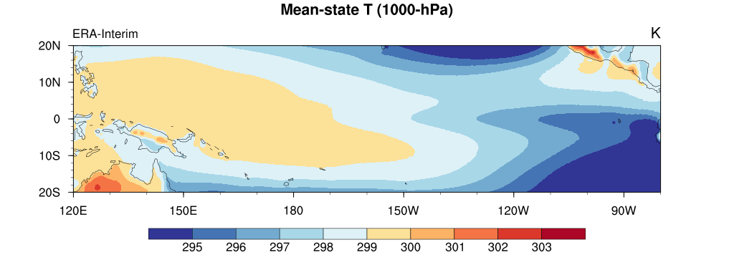
Homework-1
37
Bonus
Use SST data in "/data/course/ERA-Interim/Monthly/0.5x0.5/Global/SST".
Plot a figure of mean-state SST averaged from 1980 to 2009
Title string: Mean-state SST (1980-2009)
File name: [your name + _bonus.png].

Slide 38

NCL workshop (中文線上課程)
38
FB : 林育慎
 | Monday | Tuesday | Wednesday | Thursday | Friday
1 | X | X | X | X | X
2 | X | X | X | X | X
3
4
5 |  | ▲
6 |  | ▲
7 |  | ▲ |  | X
8 |  | ▲ |  | X

Slide 39



